Slide 1
JSC 270 - LAb 9
Clustering

Slide 2
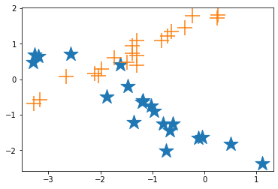
data
40 points
2 features
2 clusters
Notes:
I generated this data for purpose of example

Slide 3
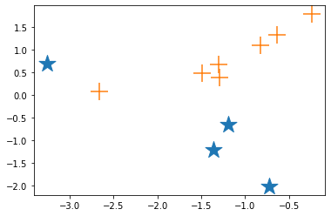
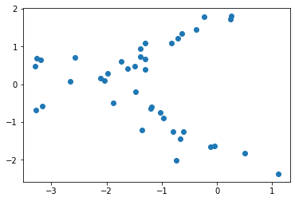
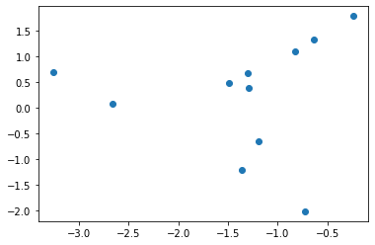
data
Original data
What we see
A subsample of 11 points

Slide 4
K-means - Algorithm
Decide on the number of clusters K
Pick K centroids (ie. cluster centers) at random
Repeat the following until convergence:
Compute the distance from each point to each centroid and assign points to the cluster with the closest centroid
Re-compute the centroid for the current cluster using all assigned points
Notes:
Centroid - cluster center is the average

Slide 5
K-Means
F
D
E
K
A
C
J
B
H
G
I
Notes:
Lets label the each data point

Slide 6
K-Means
F
D
E
K
x
A
C
J
B
H
G
x
I
Notes:
Initiate K = 2 and 2 corresponding centroids

Slide 7
K-Means
F
D
E
K
x
A
C
J
B
H
G
x
I
Notes:
Compute distances and assign each point to cluster with closest centroid

Slide 8
K-Means
F
D
E
K
x
A
x
C
J
B
x
H
G
x
I
Notes:
Recompute the centroids using the assigned points

Slide 9
K-Means
F
D
E
K
x
A
x
C
J
B
x
H
G
x
I
Notes:
Recompute distances to assign cluster membership with the new centroids

Slide 10
K-Means
F
D
E
K
x
A
x
x
C
J
B
x
x
H
G
x
I
Notes:
Recalculate the centroids

Slide 11
K-Means
F
D
E
K
x
A
x
x
C
J
B
x
x
H
G
x
I
Notes:
Recompute distance and assign cluster membership for each point

Slide 12
K-Means
F
D
E
K
x
A
x
C
x
B
J
x
x
x
H
G
x
I
Notes:
Recompute centroids - this is where convergence happened

Slide 13
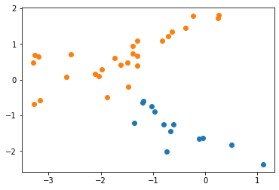
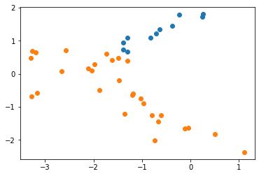
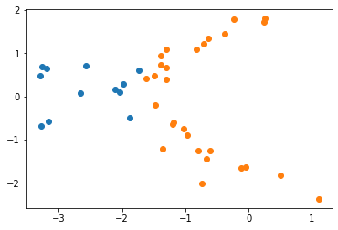
K-Means
Depends on initial conditions
Notes:
K-means is very sensitive to the initial conditions - these are 3 runs for our full data using 3 different starting points

Slide 14
How to make K-Means more robust?
Notes:
Allow for students to answer

Slide 15
How to make K-Means more robust?
Run many times (scikit version default is 10)
Have a better than random initialization
Pick data points as initializations
k-means++

Slide 16
How to make K-Means more robust? k-means++
Choose one center uniformly at random among the data points.
For each data point x not chosen yet, compute D(x), the distance between x and the nearest center that has already been chosen.
Choose one new data point at random as a new center, using a weighted probability distribution where a point x is chosen with probability proportional to D(x).
Repeat Steps 2 and 3 until k centers have been chosen.
Now that the initial centers have been chosen, proceed using standard k-means clustering.
Notes:
It is up to you if you want to cover this (feel free to delete)

Slide 17
k-MEANS
Advantages
Fast
Makes relatively few assumptions
Stable when robust initialization is used
Disadvantages
Depends on the initialization
Can get stuck in local minimum
Notes:
This covers the review of K -means - you’ll come back to the rest of the slides later in the lab.

Slide 18
A bit about selecting the number of clusters
General approach
Apply clustering for k = 1,...,K (e.g. K = 10)
For each k, compute a statistic
Plot statistic as a function of k

Slide 19
VARIOUS STATISTICS for selecting the number of clusters
Silhouette
Gap
Elbow
Sanky Plot
Information Criterion
AIC
BIC
...
Notes:
There are many measures to help us choose the number of clusters

Slide 20
VARIOUS STATISTICS for selecting the number of clusters
Silhouette
Gap
Elbow
Sanky Plot
Information Criterion
AIC
BIC
...
Notes:
We’ll briefly review 4 of the most common that are used for many types of clustering algorithms (eg. K means or hierarchical)

Slide 21
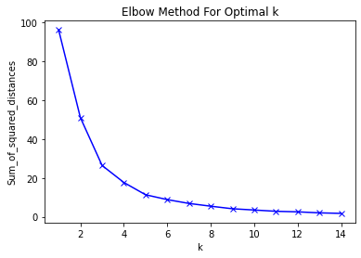
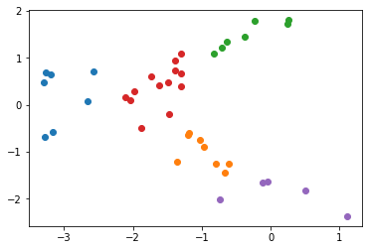
Elbow
Elbow method- heuristic
Elbow in the plot of the sum of squared distances to the nearest centre
Notes:
The K is chosen where the “elbow” occurs - ie where the plot bends - for our data (the full data now of 40 points) this yields 5 clusters
You can get a SS that is a line and this method won’t work
IMO this is the weakest method that you’ll see

Slide 22




Silhouette Score
For each data point i in cluster C_{i}, let
average distance for point i to other points within its cluster
min (across clusters) of the averages of intra-cluster distances
Silhouette: , Silhouette Coefficient:
average over all points
Kauffman and Rousseeuw (1990)
Notes:
This method is used a lot (and the one we’ll implement in lab)! Intuition - compare average distance of points within a cluster to the distance of points in other clusters
Denominator is the largest of all points
Note that the s(i) requires at least one point in the cluster to be computed - it is zero otherwise
Also, s(i) is a value that is bounded between -1 and 1
The silhouette coefficient (SC) is the maximum value of the mean of the s(i) over all data
stilde(k) is the mean s(i) is the mean over all data points for a specific choice of k
Note - a higher silhouette score is preferable

Slide 23
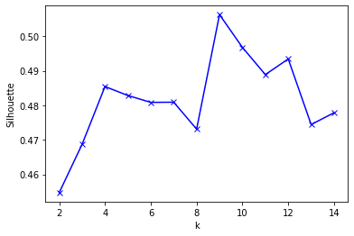
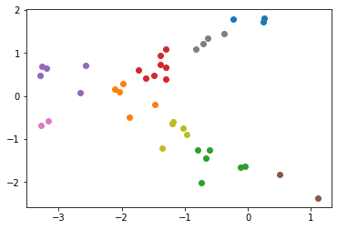
Silhouette Score
k=9
Kauffman and Rousseeuw (1990)
Notes:
Here we select 9 clusters - this is a lot of clusters for the points (we only have 40 here)
If you want to optimize tightness of clusters then the silhouette score is the proper metric to use
This is the metric we will investigate in lab - we’ll cover two more so you are aware of them if you see them in the future

Slide 24

GAP statistic
D_{i}=𝝨_{h,k∈Ci} d_{hk}- sum of pairwise distances in cluster i
W_{k} = 𝝨_{i=1..k}1/(2n_{i})D_{i} - pooled within cluster sum of distances
Main idea: compare log(W_{k}) to expectation under the null distribution
Tibshirani et al (2000)
Notes:
The gap statistic comes from the statistical literature and compares the total within intra-cluster variation for different values of k with their expected values under null reference distribution which assumes a single cluster. The estimate of the optimal clusters will be value that maximize the gap statistic (i.e, that yields the largest gap statistic). Intuition - the farther you are from the null, the more evidence you have that are K clusters.

Slide 25
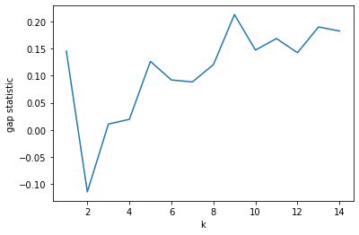
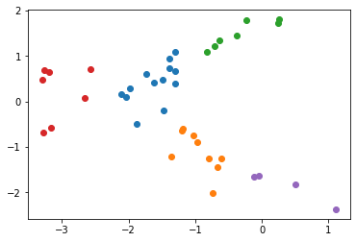
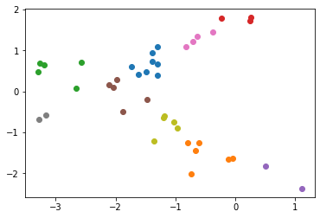
GAP statistic
k=5
k=9
k=5 k=9
Notes:
Here it looks like 5 or 9 are reasonable as there are two peaks in the graph - note that K =2 (how the data were generated) is the worst! You always want to look at the whole curve because often the larger choice of K (here 9) will just break up clusters from a smaller choice of K (here 9).

Slide 26
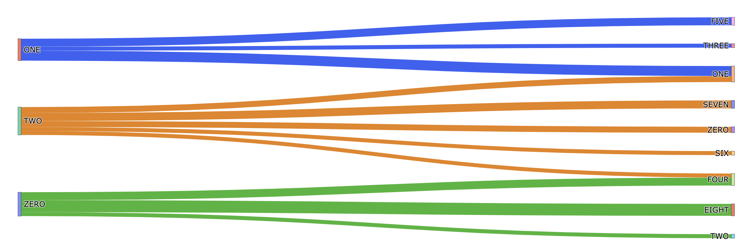
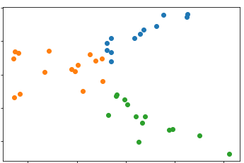
Alluvial (SANKY) PLOT
k=3
k=9
Notes:
Lastly, the sanky or alluvial plot is another useful tool to understand your cluster results. This plot builds on the idea of what we just saw with gap statistics - just a higher choice of K just break up clusters or is something else going on. You can see we have something else going on - there are two clear subclusters ( top 2 blue lines on right and bottom 2 green lines on green) and there is some merging among the orange group to to the green and blue (ie the third blue line and the first orange line on the right and the 1st green line and 5th orange line on the right). This plot is useful to understand if you have found pure “subtypes” (for instance sub-types of certain diseases).

Slide 27
SUMMARY
There are MANY clustering methods
We saw agglomerative hierarchical clustering and K-means
There is no one perfect method that works for every dataset
There are many ways to select the number of clusters
Examine multiple methods for each dataset
Visualizations help to analyze clustering

